Slide 1
MODULE 2- SYLLABUS - I/O Interfacing Techniques
UART(Universal Asynchronous Receiver/Transmitter)
8251 IC

Slide 2
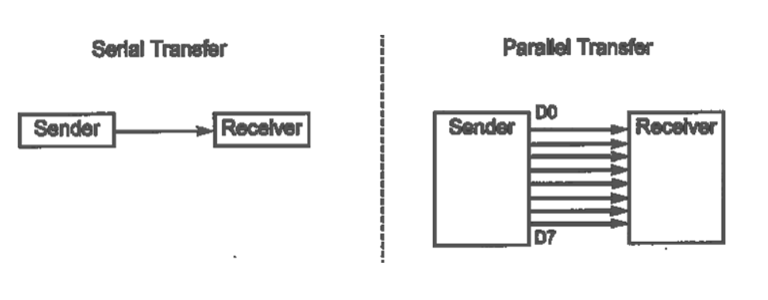
SERIAL COMMUNICATIONS
serial communication is used for transferring data between two systems located at distances of hundreds of feet to millions of miles apart.

Slide 3
SERIAL COMMUNICATIONS
Since serial communication uses single data line instead of the 8-bit data line of parallel communication,
it is much cheaper and also it enables two computers located in two different cities to communicate over the telephone.
For serial communication to work, byte of data must be converted to serial bits using a parallel in serial out shift register, then it can be transmitted over a single data line.

Slide 4
SERIAL COMMUNICATIONS
At the receiving end, there must be a serial in parallel out shift register to receive the serial data and pack them into a byte.
Serial data communication uses 2 methods, synchronous and asynchronous.
The synchronous method transfers a block of data(characters) at a time, while the asynchronous method transfers a single byte at a time

Slide 5
Asynchronous serial communication
It is difficult to make sense of the data unless sender and receiver agree on a set of rules, a protocol, on how the data is packed, how many bits constitute a character, and when the data begins and ends.
Asynchronous serial data communication is widely used for character-oriented transmissions, while block-oriented data transfers use the synchronous.
In the asynchronous method, each character is placed between start and stop bits.

Slide 6
UART
UART stands for Universal Asynchronous Receiver/Transmitter.
8051 has built in UART, communication circuit use SUBF register to hold the data.
A UART’s main purpose is to transmit and receive serial data

Slide 7
UART
In UART communication, two UARTs communicate directly with each other.
The transmitting UART converts parallel data from a controlling device like a CPU into serial form,
transmits it in serial to the receiving UART, which then converts the serial data back into parallel data for the receiving device.

Slide 8
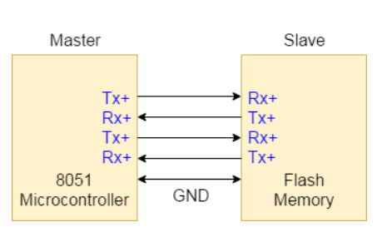
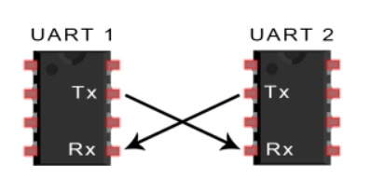
UART
Only two wires are needed to transmit data between two UARTs. Data flows from the Tx pin of the transmitting UART to the Rx pin of the receiving UART:

Slide 9
UART
UARTs transmit data asynchronously, which means there is no clock signal to synchronize the output of bits from the transmitting UART to the sampling of bits by the receiving UART.
Instead of a clock signal, the transmitting UART adds start and stop bits to the data packet being transferred.
These bits define the beginning and end of the data packet so the receiving UART knows when to start reading the bits.

Slide 10
UART
When the receiving UART detects a start bit, it starts to read the incoming bits at a specific frequency known as the baud rate.
Baud rate is a measure of the speed of data transfer, expressed in bits per second (bps).
Both UARTs must operate at about the same baud rate. The baud rate between the transmitting and receiving UARTs can only differ by about 10% before the timing of bits gets too far off.

Slide 11
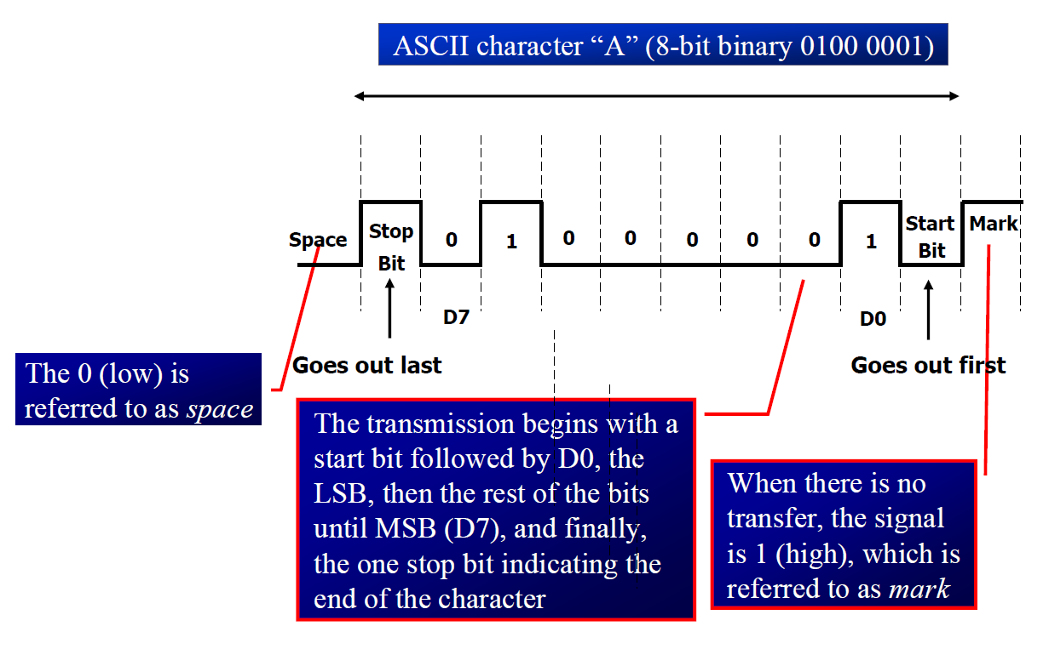
UART– Start & Stop Bit

Slide 12
UART
START BIT
When there is no transfer, the signal is 1 – referred to as mark. The 0 is referred to as space
(The UART data transmission line is normally held at a high voltage level when it’s not transmitting data)
To start the transfer of data, the transmitting UART pulls the transmission line from high to low for one clock cycle
When the receiving UART detects the high to low voltage transition, it begins reading the bits in the data frame at the frequency of the baud rate.

Slide 13
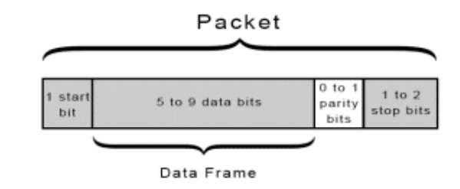
UART-Data Frame

Slide 14
UART
Data Frame: The data frame contains the actual data being transferred. It can be 5 bits up to 9 bits long if a parity bit is used.
If no parity bit is used, the data frame can be 8 bits long. In most cases, the data is sent with the least significant bit first.
PARITY BITS
The parity bit is a way for the receiving UART to tell if any data has changed during transmission.
Bits can be changed by electromagnetic radiation, mismatched baud rates, or long distance data transfers

Slide 15
UART
STOP BIT
To signal the end of the data packet, the sending UART drives the data transmission line from a low voltage to a high voltage for at least two bit durations

Slide 16
Serial Interface
The serial port of 8051 is full duplex, i.e., it can transmit and receive simultaneously.
The register SBUF is used to hold the data.
The special function register SBUF is physically two registers.
One is, write-only and is used to hold data to be transmitted out of the 8051 via TXD.
The other is, read-only and holds the received data from external sources via RXD. •Both mutually exclusive registers have the same address 099H.

Slide 17
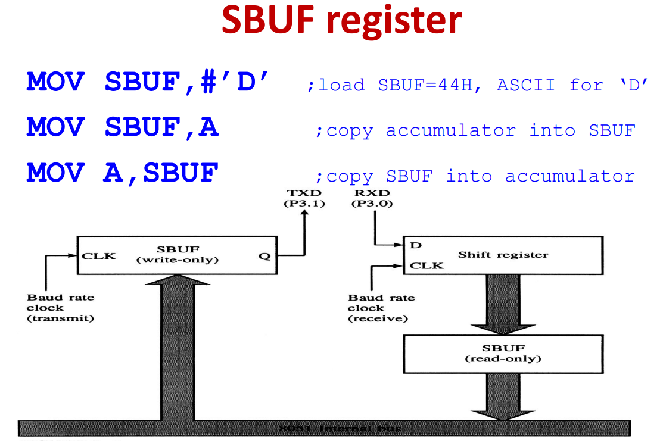
SBUF REGISTER

Slide 18
Serial Port Control Register (SCON)
Register SCON controls serial data communication. Address: 098H (Bit addressable)
This special function register (SFR) controls the operations of the serial port.
This register is used to define the operating modes.
This also receives the 9th bit and contains the transmit and receive interrupt flags as well.

Slide 19
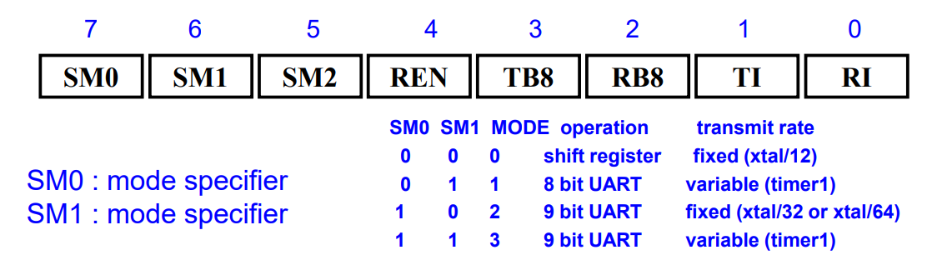
Serial Port Control Register (SCON)

Slide 20
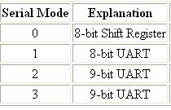
SCON Register
SM0 SM1 SM2 REN TB8 RB8 TI RI
Set when a Cha-
ractor received
Set to Enable
Serial Data
reception
Set when Stop bit Txed
Enable Multiprocessor
Communication Mode
9th Data Bit
Sent in Mode 2,3
9th Data Bit
Received in Mode 2,3

Slide 21
(SCON)
SM2 : used for multi processor communication
REN : receive enable (by software enable/disable)
TB8 : transmit bit 8-used for serial mode 2 & 3 (start bit)
RB8 : receive bit 8-In serial mode 1, this bit gets a copy of the stop bit when an 8-bit data is received

Slide 22
(SCON)
TI : transmit interrupt flag set by Hardware after send , clear by Software-when the 8051 finishes the transfer of the 8-bit character,
it raises the TI flag to indicate that it is ready to transfer another byte
RI : receive interrupt flag set by Hardware after received ,clear by Software
When the 8051 receives data serially via RxD, it gets rid of the start and stop bits and places the byte in SBUF register

Slide 23
(SCON)
Bits SM0 and SM1 let us set the serial mode to a value between 0 and 3, inclusive.
When SM2 is set the "RI" flag will only be triggered if the 9th bit received the interrupt signal (As “1”).
The next bit, REN, is "Receiver Enable." This bit is very straightforward: If you want to receive data via the serial port, set this bit. You will almost always want to set this bit.

Slide 24
(SCON)
The TB8 bit is used in modes 2 and 3. In modes 2 and 3, a total of nine data bits are transmitted.
The RB8 also operates in modes 2 and 3 and functions essentially the same way as TB8, but on the reception side.
When a byte is received in modes 2 or 3, a total of nine bits are received.

Slide 25
8051 Serial Port – Mode 0
The Serial Port in Mode-0 has the following features:
Serial data enters and exits through RXD
TXD outputs the clock
8 bits are transmitted / received
The baud rate is fixed at (1/12) of the oscillator frequency

Slide 26
8051 Serial Port – Mode 1
The Serial Port in Mode-1 has the following features:
Serial data enters through RXD
Serial data exits through TXD
On receive, the stop bit goes into RB8 in SCON
10 bits are transmitted / received
Start bit (0)
Data bits (8)
Stop Bit (1)
Baud rate is determined by the Timer 1 over flow rate.

Slide 27
8051 Serial Port – Mode 2
The Serial Port in Mode-2 has the following features:
Serial data enters through RXD
Serial data exits through TXD
9th data bit (TB8) can be assign value 0 or 1
On receive, the 9th data bit goes into RB8 in SCON
11 bits are transmitted / received
Start bit (0)
Data bits (9)
Stop Bit (1)
Baud rate is programmable

Slide 28
8051 Serial Port – Mode 3
The Serial Port in Mode-3 has the following features:
Serial data enters through RXD
Serial data exits through TXD
9th data bit (TB8) can be assign value 0 or 1
On receive, the 9th data bit goes into RB8 in SCON
11 bits are transmitted / received
Start bit (0)
Data bits (9)
Stop Bit (1)
Baud rate is determined by Timer 1 overflow rate.

Slide 29
UART-8051 Microcontroller Programming steps
Configure Timer 1 in auto-reload mode.
Load TH1 with value as per required baud rate e.g. for 9600 baud rate load 0xFD. (-3 in decimal)
Load SCON with serial mode and control bits. e.g. for mode 1 and enable reception, load 0x50.
Start timer1 by setting TR1 bit to 1.
Load transmitting data in the SBUF register.
Wait until loaded data is completely transmitted by polling the TI flag.
When the TI flag is set, clear it, and repeat from step 5 to transmit more data

Slide 30
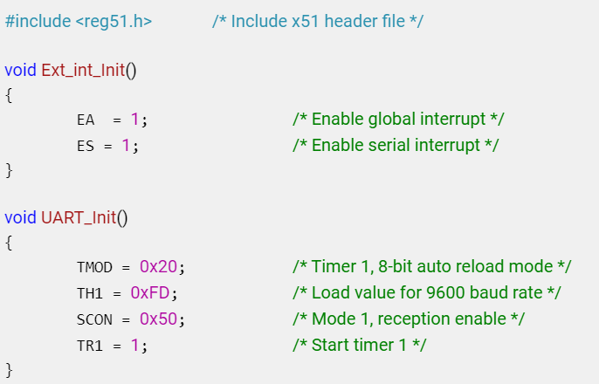
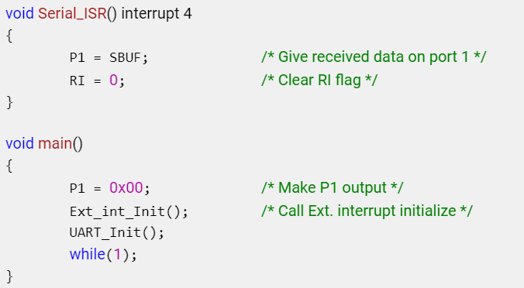
Let's Program 8051 (here AT89C51) to send character data “test” serially at 9600 baud rate in mode 1

Slide 31
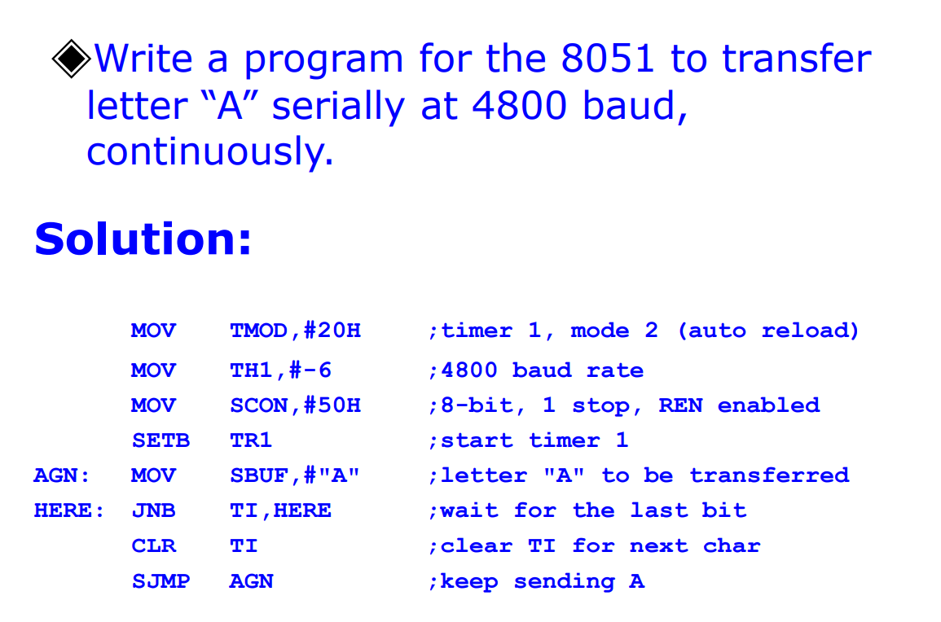

Slide 32
Advantages of UARTs
Only uses two wires
No clock signal is necessary
Has a parity bit to allow for error checking
The structure of the data packet can be changed as long as both sides are set up for it
Well documented and widely used method

Slide 33
Disadvantages of UART
The size of the data frame is limited to a maximum of 9 bits
Doesn’t support multiple slave or multiple master systems
The baud rates of each UART must be within 10% of each other

